Slide 1
American restaurant

Slide 2
Project analysis slide 2
American restaurant
Introduction
The City of Jeddah of the most populous city in the Saudi Arabia, there a lot of Cultures in Jeddah because the Muslims come there before he wants to do umrah, there is a port for receive the luggage and merchandise.
Business Problem
The client wants to start a business again and open American restaurant in Jeddah city, but the problem was in the first time he opened the restaurant, the restaurant has been failed and he didn’t know why! especially he has a branch in another city and the restaurant work doing well.

Slide 3
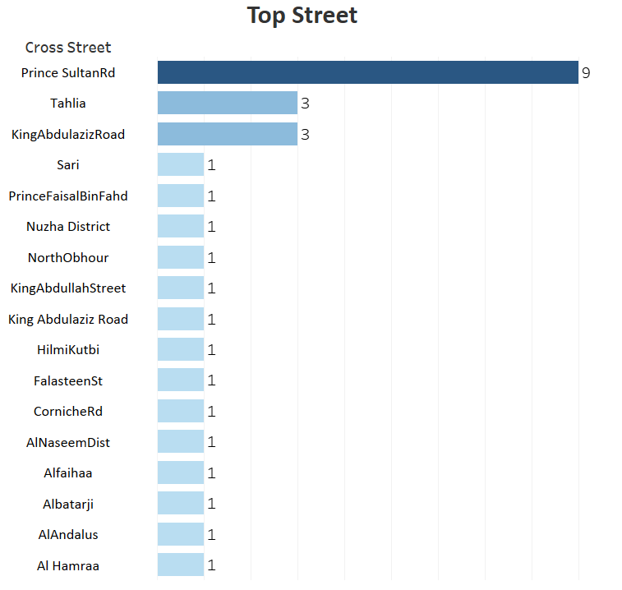
Project analysis slide 2
American restaurant
The most American restaurant

Slide 4
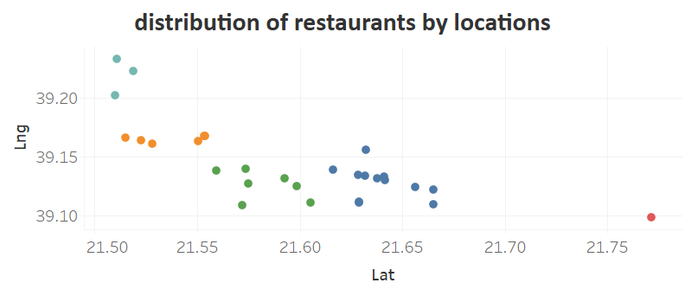
Project analysis slide 2
American restaurant

Slide 5
Project analysis slide 2
American restaurant
Conclusion:
We believe that the location One of the reasons to success the restaurant so we will find a good place to open the restaurant by using Foursquare Developer.
The Foursquare provide us a lot of information about the restaurant like location, classification and menu. so, we will use a python to collect the data, cleaning and modelling.

Slide 6
Thank You

